Slide 1

Is it cinema?
DATA 515: Software Design for Data Scientists Final Project
Dyuti Vartak
Edgar Lopez
Riyosha Sharma
Saikiran Babu

Slide 2
Background
Problem: Do you really want to spend $15 dollars watching the new release in a theater or would you rather just watch it at 2x speed from your sofa?

Slide 3

Background
Solution: We can help! We built a webtool that -
Given a Letterboxd movie link and username, provides:
a summary of the most popular reviews
an aspect based sentiment analysis of the most popular reviews
a personalized taste-match by comparing your reviews with the film reviews
Given a Letterboxd username, provides:
a roast analyzing your film preferences

Slide 4
Use Cases
#1 Film Club Screening
Want to pick a horror-comedy for Halloween screening
Need to understand
reviewers’ take
top positive/negative aspects of the movie
No technical skills required

Slide 5
Use Cases
#2 Film Producer
Want a sentiment based analysis of the most liked/disliked aspects of their film
Need to understand
top positive/negative aspects of the movie
No technical skills required

Slide 6
Use Cases
#3 Movie Night with the Gang
Want to pick a movie EVERYONE likes
Need to understand
top positive/negative aspects of many movies
film preferences of each friend
No technical skills required

Slide 7
Data Used
Scraped dynamically from letterboxd film/user link
Film link: 300 most popular reviews scraped
User profile link:
Review data scraped: movie name, rating, watched date, review
Stats data scraped: # films, # hours, # directors, # countries, longest watch streak and more

Slide 8
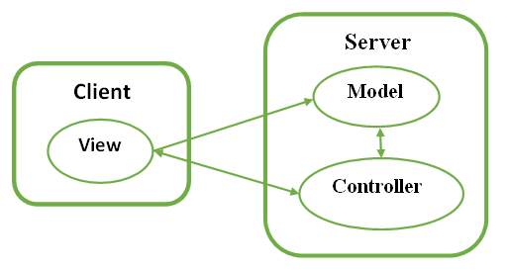
Project Architecture
MVC + Client-Server

Slide 9
Model: Scrapers+Analyzers
Movie:
Name
Genres
Image
Release Year
~ 360 most popular reviews
User Profile:
Reviews
No. of movies watched
No. of countries
Total hours watched
Longest watch streak

Slide 10
Components: Scrapers+Analyzers
Classes of generative functions to generate summaries, aspect charts, and the roast
Input: Python data structures (scraped movie and user data)
Output:
Movie reviews’ summary
Reviews’ aspect data
User roast
Vibe match summary

Slide 11
View: User Interface
Web Application built using JavaScript and React
Node.js, Vite dev framework, React reusable components libraries
Asynchronous data fetching
Lego block building
Input: Letterboxd Movie url and/or Username
Output: movie details
Reviews’ summary
Sentiment-based aspect analysis charts
Vibe match analysis
User Profile Roast

Slide 12
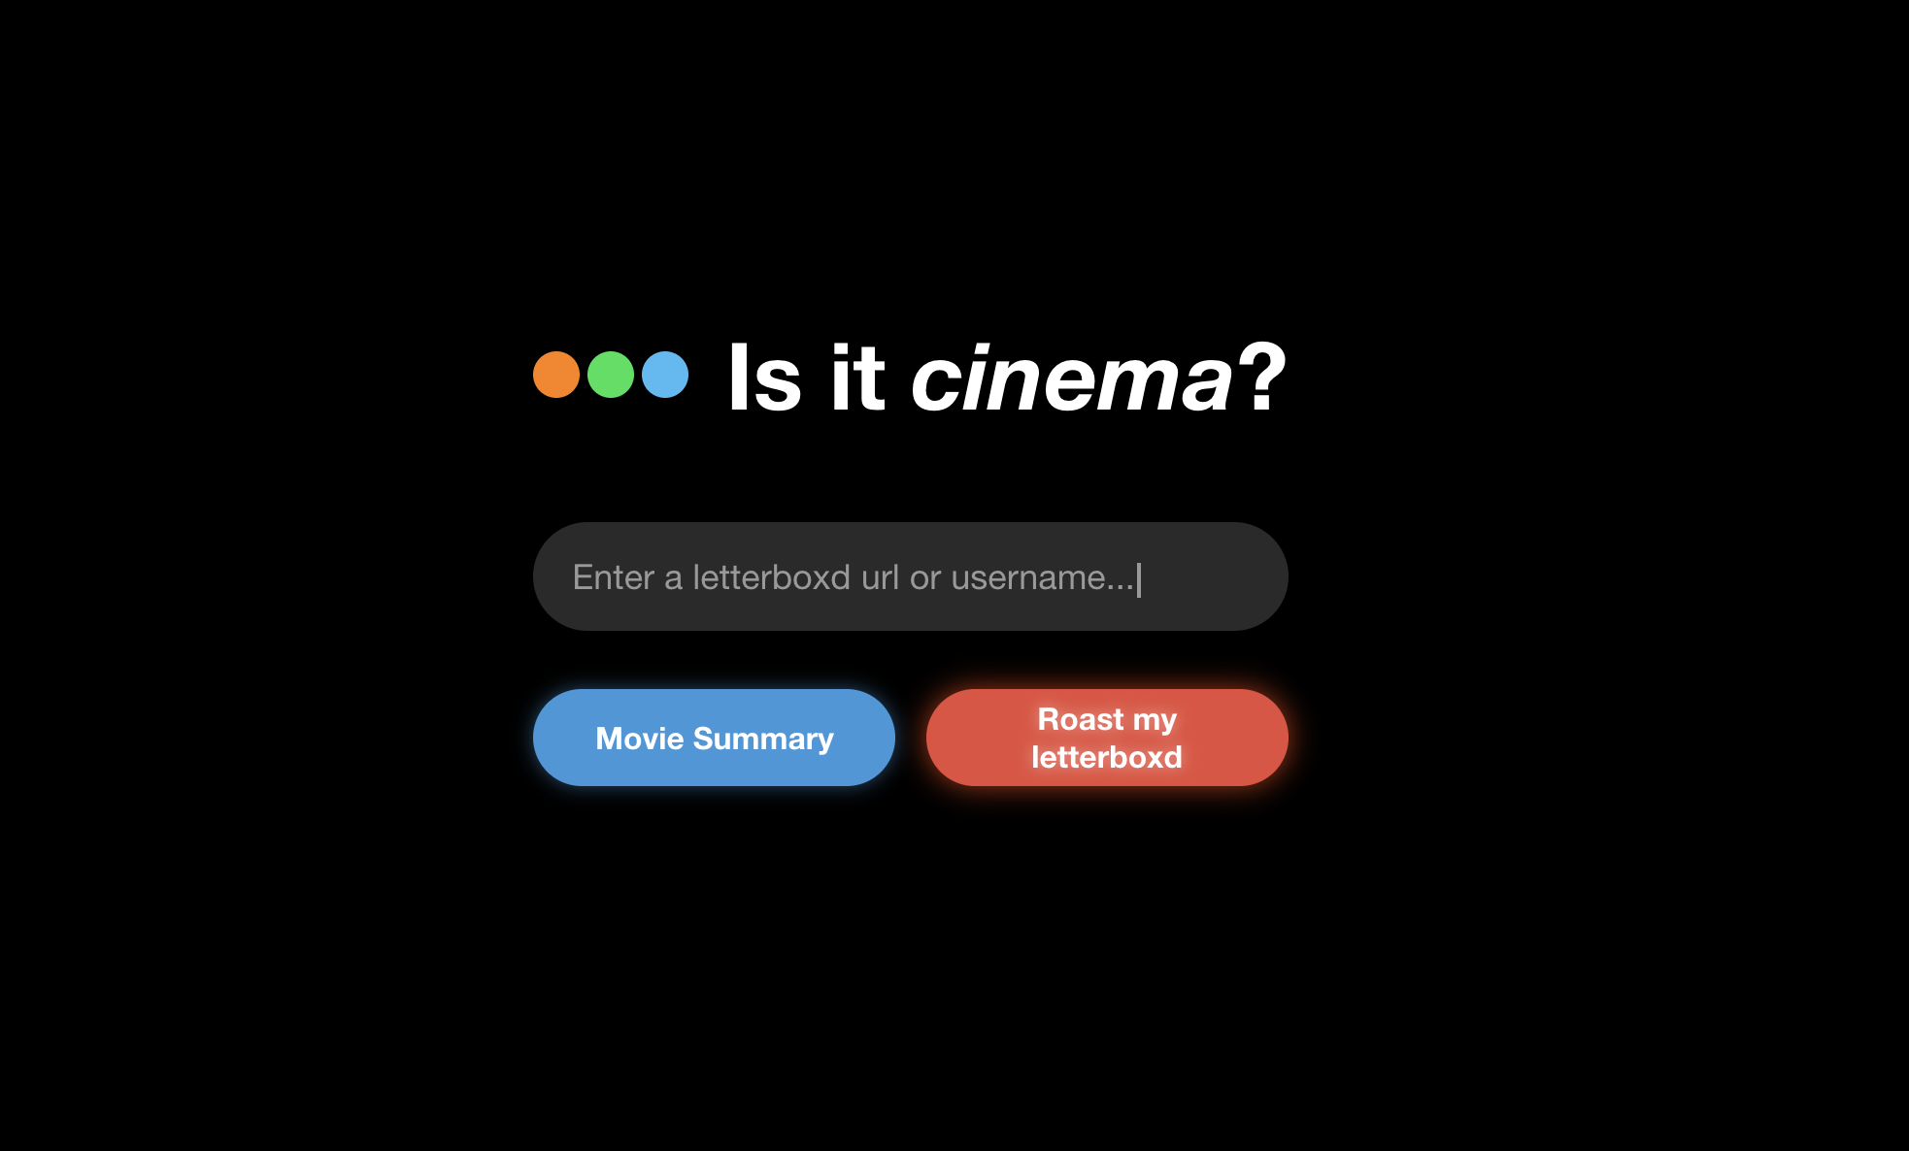
View: User Interface

Slide 13
Controller
Flask API for connection between source URL and Views
3 endpoints:
movie_details - returns details about the movie
roast - roasts the user based on their Letterboxd history
taste - tells whether a particular movie is of the user’s taste
Each endpoint returns output in JSON format

Slide 14
Demo!!

Slide 15
Lessons Learned and Future Work
Deployment!
Use LangChain and RAG models to make site conversational
Git config on day 1 and not T-1 (;-;)
Test-driven development
Our application is dependent on Letterboxd site formatting
Docker!

